Slide 1
Que bom que você veio!
Vamos esperar alguns minutos até todo mundo chegar.

Slide 2
Organização Autônoma
Formação original do Coletivo União & Luta Adaptado e traduzido pela FOB
Notes:
(SLIDE 2) Welcome to the autonomous organizing training!
Facilitators introduce themselves
Introduce the workshop
As revolutionaries, we help movements become more powerful, self-aware and self-determined. We do more than armchair commentary on movements, or just showing up to events as individuals. We work collectively to help movements grow through "organizing." But what does this look like in practice?​​​
We often find ourselves in struggles where people lack a shared organizing model. Folks get involved through different routes and carry bits of what they've learned (from nonprofits, punk subcultures, churches...)
We built this workshop to provide a shared foundation. It's oriented toward people who are already trying to organize (what we call the "intermediate layer" as opposed to the mass layer.) It works best if you have some experience, you're burned out on activism, you want to get more serious about strategy and building long-term.
We have lots of other organizing tools that we've drawn on over time and adapted to our politics. We can keep sharing and developing those as we work together. And you all are free to use this workshop, to share it with others, whatever.
Participants Introduce themselves

Slide 3
Roteiro
Definindo Organização Autônoma
Planejando uma campanha
Pausa para comer
Conversando sobre política
O dia a dia
Conclusão
Notes:
(SLIDE 3) Schedule
This is what we’re doing today
This isn’t school, take a break if you need to. do whatever you need to do.
This isn’t a lecture and we’re not experts. There’s gonna be a lot of interactive parts. Ask Qs, chime in, add things we missed
We hope to develop expertise together!
Logistics
You’re welcome to use the chat
Raise hand function or chat for stack, if it feels right unmute yourself and jump in.

Slide 4
Definindo Organização Autônoma
Defina “Organização” em suas próprias palavras.
Notes:
(SLIDES 4-5)
Can you define organizing in your own words?

Slide 5
Definindo Organização Autônoma
Os modelos de organização surgem da teoria.
Alguns modelos são dominantes e suas teorias não são exploradas.
Estamos desenvolvendo novos modelos juntos.
Notes:
(SLIDES 4-5)
Can you define organizing in your own words?
Models for organizing arise from theory
There are different models for organizing, each of which implies its own theory of change.
Example: some models focus on gaining a hearing or representation from parts of the bourgeois state. They are premised on the theory that capitalism will fix itself once the political system represents our interests.
Some models are dominant, and their theories get assumed in the background.
Example: people know the methods of MoveOn.org or People’s Action even if they don’t know them by name.
These orgs mobilize members to pressure elected officials, move legislation, and get new candidates elected.
People assume these models when they call for familiar tactics by default. They make moralistic arguments (“we have to make our voices heard”) without assessing the theory of change behind them.
We need to develop new models together
We can’t adopt old models wholesale. But the point isn’t to throw them out and start from scratch, either.
Old models might have useful elements, like a good playbook for doing doorknocking.
Instead, we should adapt elements that work in a new model, which derives from revolutionary theory and builds revolutionary movement.
See “New Tools Needed”: http://www.unityandstruggle.org/2019/03/new-tools-needed-community-organizing/

Slide 6
Definindo Organização Autônoma
Ao confrontar coletivamente aqueles que nos exploram e oprimem, construímos relacionamentos e organizações que funcionam de forma independente das instituições da classe dominante (polícia, patrões, proprietários, o Estado, às vezes sindicatos ou ONGs).
Isso nos permite exercer poder no nosso dia a dia e, no fim das contas, em toda sociedade.
Notes:
(SLIDE 6) Defining Autonomous Organizing
Read quote
This definition is broad. It may feel easy to agree with, but it differs from many models out there today
It acknowledges that we are exploited and oppressed (at work, as people of color, for our sexual or gender expression. by capitalists, racists, misogynists.)
It works by breaking up with the institutions that sustain our exploitation and oppression, not by lobbying or joining them
It aims at a revolution where we take control of how society is reproduced and run
Let’s break this down by looking at keywords that we’ll return to throughout this workshop

Slide 7
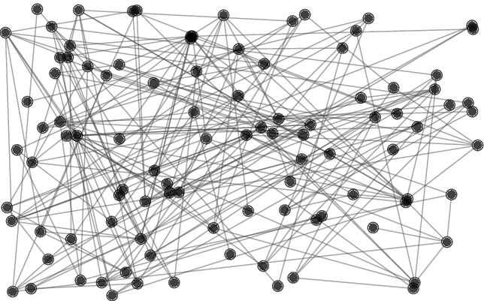
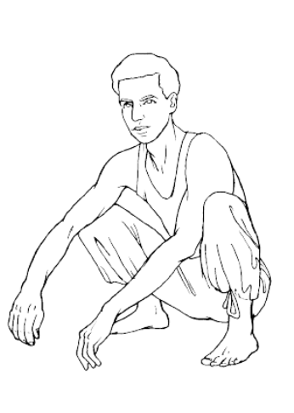
Definindo Organização Autônoma
CÓCORAS
Comuns
Confrontam em
Rede
Autônoma
Solidária
Notes:
(SLIDE 7) Defining Autonomous Organizing=
Autonomy
Autonomy is our ability to define goals and act collectively, independent from how our exploiters and oppressors understand our situation, and the avenues they create to channel our actions.
Organizing autonomously may mean not working with management or government (or unions or nonprofits, if they help manage our exploitation and oppression). Relying on our relationships and resources we have some control over.
(Note: some ppl use “autonomy” to mean each individual is free to act however they like, and no one can tell anyone else what to do. This is different: it’s about breaking with oppressive institutions and creating our own collective organization.)
Confrontation
People only realize their autonomous power through collective action
So, building power entails confronting exploitative and oppressive people and institutions
Autonomy develops over time through these confrontations and breaks. On a small scale, it could mean forming a friend group without the manager. On a big scale, it could mean forming workers councils or self-governing territories.
Everyday lives
Organizing starts by confronting the exploitation and oppression we experience in our everyday lives (at work, school, the neighborhood, home).
By building on what people already experience and care to confront, we draw in those who aren’t already involved in struggles, don’t already self-identify as a revolutionaries, or don’t already have a robust theory of liberation.
The movement grows by constantly drawing in new people, building links between their struggles, and discovering how they imply overthrowing capitalism as a whole.
Questions
Can you think of any examples of this type of ACE organizing?
What is our role as organizers in ACE?

Slide 8
Definindo Organização Autônoma
Organizador = Diretor do Sindicato?
Organizador = Chefe de uma ONG?
Organizador = ???
Notes:
(SLIDE 8) Defining “organizer”
What is an organizer?
We may imagine a union staffer, a nonprofit director, or this box in my underwear drawer
Eric Mann’s Playbook for Progressives says an organizer is
(1) A dedicated foot soldier in the day-to-day work of organizing
(2) An evangelist for the cause, inspiring and motivating others
(3) A recruiter, constantly inviting more people deeper into the work
(4) A group builder, helping groups of people work better together
(5) A strategist, outlining courses of action
(6) A tactician, acting creatively and flexibly on their feet
(7) A communicator, able to encapsulate the story of the struggle clearly and succinctly
(8) An educator, deepening people's understanding of the meaning and context of the struggle
(9) An agitator, amplifying people effectively
(10) A fund-raiser, translating relationships into money to sustain campaigns
(11) A comrade and confidante, reliable and empathic with others in all aspects of their lives
(12) A cadre, dedicated to grow movements and replace themselves
Organizers can be grown
When I first started organizing, I would see certain people and think ‘wow, this person is a natural leader. They were made for this. I can never be like that.’
I’ve come to learn that organizers are not born; they’re made. We CAN and SHOULD develop our skills as organizers.
The goal is to replace ourselves: to build those autonomous relationships and organizations so that resistance can sustain itself

Slide 9
Definindo Organização Autônoma
2) Liste habilidades e traços importantes de um organizador.
Notes:
Question: What are the traits of an organizer? What roles does an organizer take on?

Slide 10
Definindo Organização Autônoma
O que nós precisamos?
Habilidades de pensamento estratégico.
Habilidades sociais.
Habilidades de organização e de grupo.
Ensinar e aprender.
Notes:
(SLIDE 10)
What do we need
Individual strategic thinking skills: goals, strategy, tactics, reflection, etc.
Social skills: talking politics, empathizing and caring for each other, inspiring others, and most importantly helping others develop these skills
Group skills: making decisions collectively, thinking strategically together, dealing with conflict and disagreement, reflecting together, etc.
Theoretical development: learning from historical wins and losses, studying models of organizing and theories of how we transform our world.
Link to list of leadership qualities we came up with during quarterly (link)

Slide 11
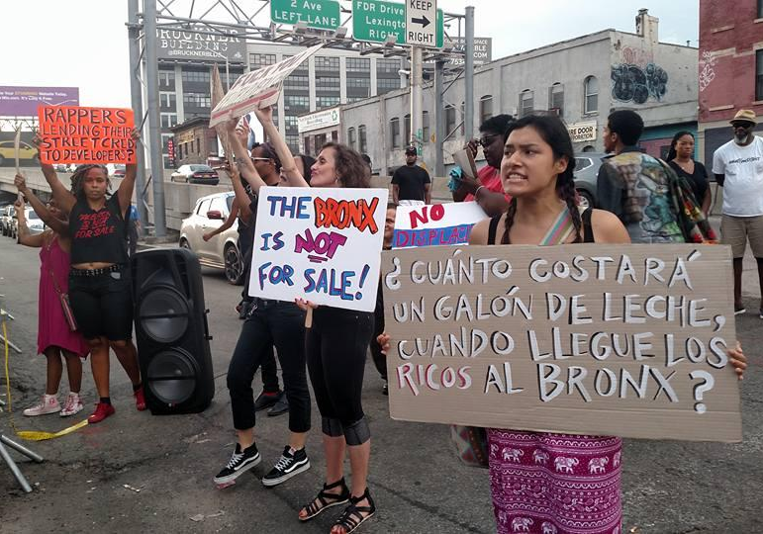
Planejando uma Campanha
O terreno
Objetivos
Estratégia
Táticas
Referências
Notes:
(SLIDE 13) Intro:
Let's say you do a one-off action around some issue. But the issue isn't resolved. It crops up again. So you do more actions. Pretty soon, you're meeting other people who care about the issue. You start asking how to get more people involved, and what a good outcome would be.
That means you're in a "campaign": an extended struggle with the ruling class over some aspect of class existence that sucks, and that people are willing to fight over. As organizers, we help communities develop, wage, and win campaigns to strengthen our autonomy and weaken capitalist rule.
We are covering several aspects of planning campaigns: the Terrain, Goals, Strategy, Tactics, & Benchmarks

Slide 12
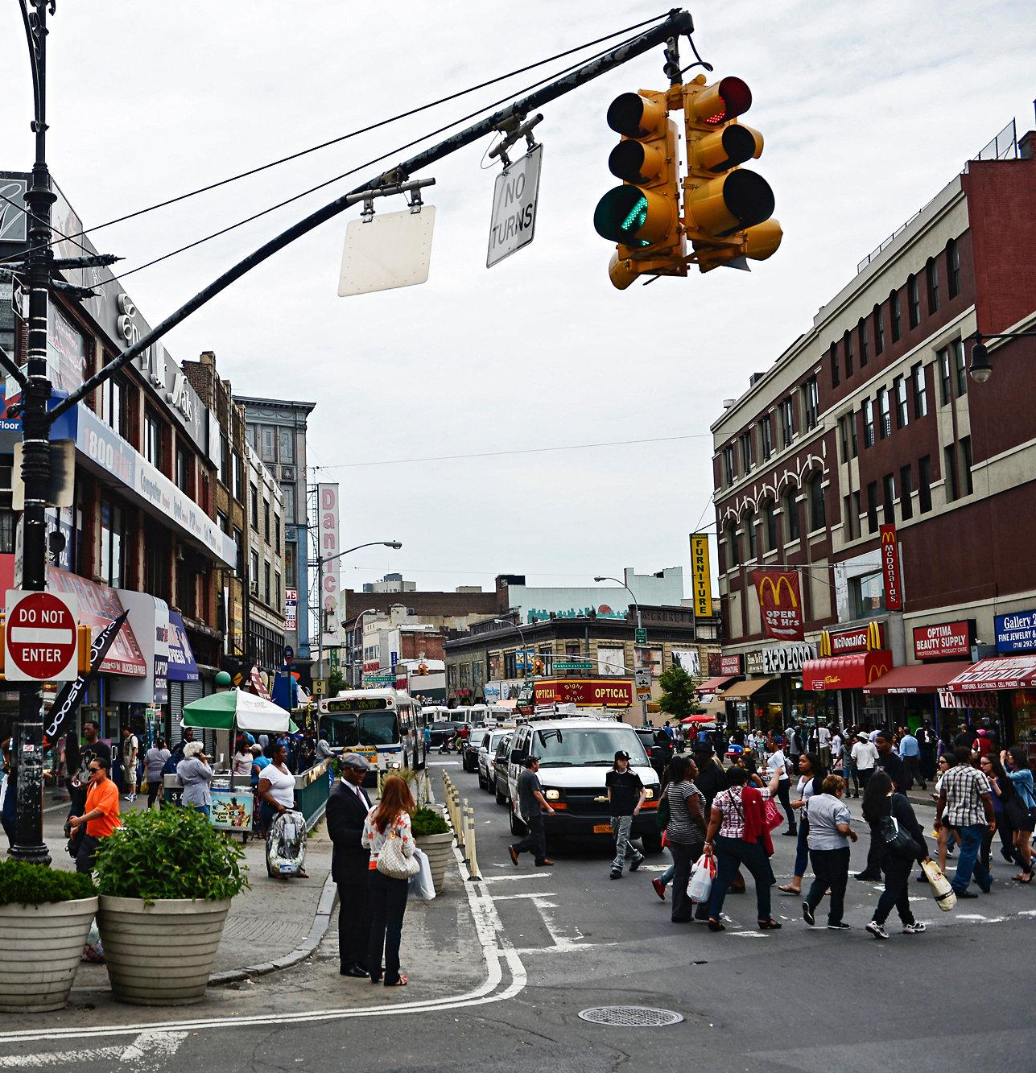
Planejando uma Campanha
Avaliar o terreno
O que nós sabemos?
O que nós precisamos saber?
Como podemos descobrir?
Notes:
(SLIDE 15) Terrain:
The first thing you have to do when a campaign starts is assess the "terrain." Your campaign takes place in a particular territory (a neighborhood, workplace, housing portfolio etc). It's trying to engage working class people to change that reality -- people with common patterns of work, school, home, and family, with shared histories of oppression and resistance.
What information is useful when we begin organizing? What do we need to know about the people and the place? Who are all the players to consider? What do we need to know about ourselves? How can we find that out?
Open Question 4: Brainstorm on the board together. What do we know; what do we need to know?
Backpocket:
MST's Method of Work and Popular Organization manual says we must study things like "the situation of exploitation and misery in which the masses live; problems they confront...history of developed struggles and their results; forces that dominate and control the masses (of the right and left); what is their... predominant culture, symbols and beliefs, sentiments; taboos; pastimes; degree of literacy; geographic concentration; and possibility of articulation and amplification through the movement."
How do people relate to each other? What organic infrastructures or networks exist already?
How have people either adapted to or resisted their conditions?
What are the identities and social statuses of people affected?
Who are the enemies and potential allies in the struggle?
What’s the history of struggle in the area?
How do people understand their oppression?
What ideas do people have right now about how to fight back?
What kind of repression might we face?

Slide 13
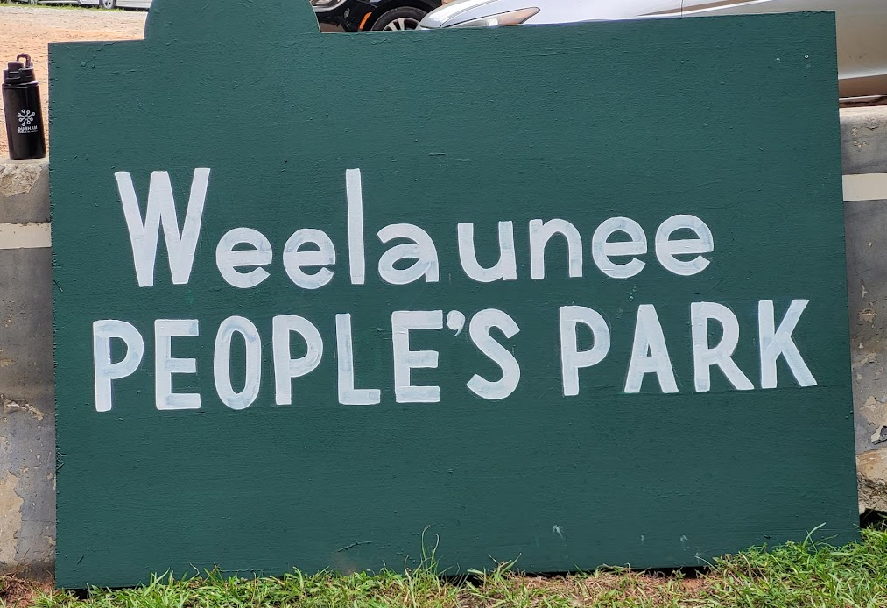
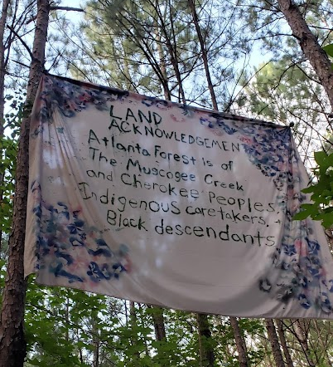
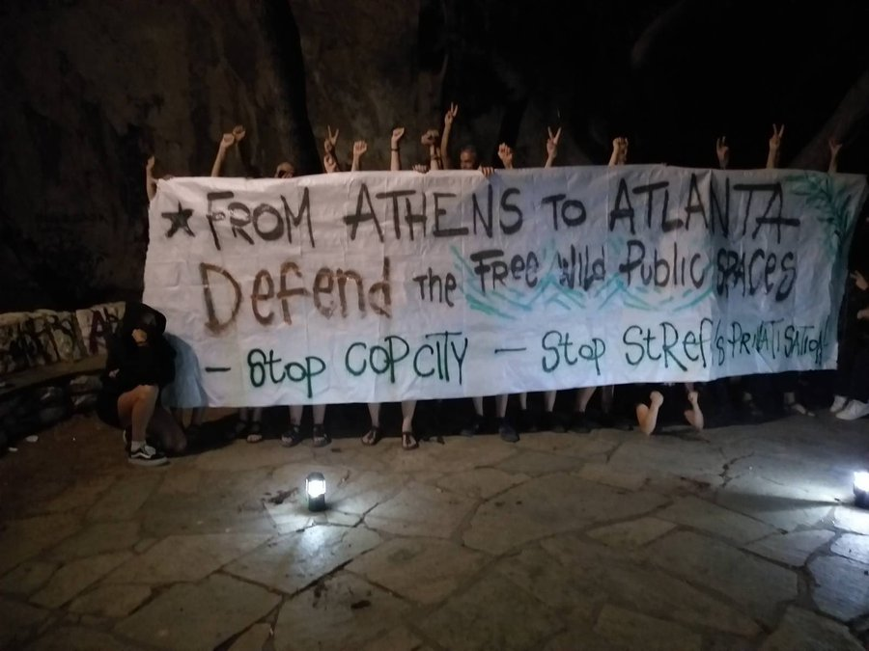
Planejando uma Campanha
OBJETIVOS: O QUE nós queremos conquistar.
Como isso vai dividir a classe dominante?
Como isso vai construir um poder autônomo?
Se isso for feito, a nova situação será favorável ou facilmente usada contra nós?
-
Notes:
(SLIDE 17) Goals
We’re going to go through goals, strategy and tactics next. It’s important to note that these things are fluid, often overlapping, and not linear. Afterwards, we’ll break into smaller groups where you’ll all identify goals, strategy and tactics for your organizing.
Definition: WHAT you hope to achieve
In the rezoning fight: the goal was to stop proposed Southern Blvd rezoning. Other goals came into focus along the way, because we felt the need for positive goals as well -- not just stop the ruling class from doing something, but take the initiative and impose something we want. I'll get into that more.
Guiding questions:
If this goal is achieved, how will it divide political and economic elites?
How will this build autonomous power among our class, our people?
If we accomplish our goals, will the new situation be favorable or easily used against us? We want an end-state where it's easier for us to live and fight, and harder for them to rule.

Slide 14
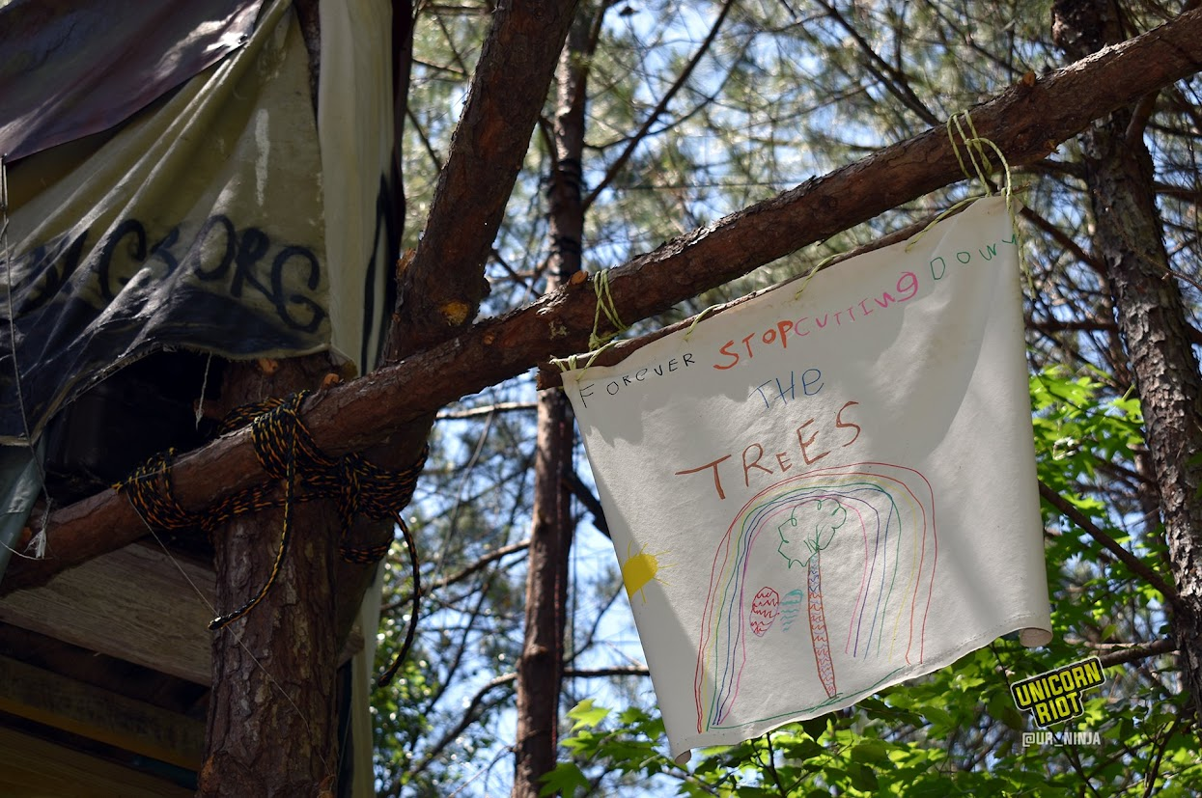
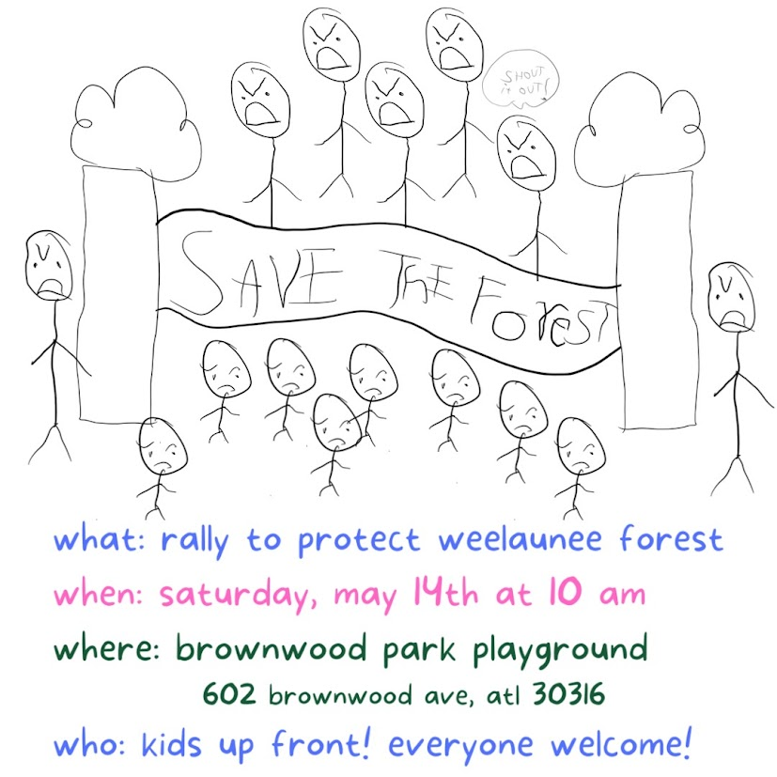
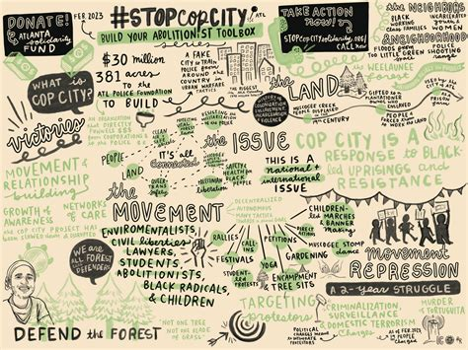
Planejando uma Campanha
ESTRATÉGIA: COMO nós queremos conquistar isso?
Como nossa estratégia se alinha com nossos objetivos?
Ela facilita o engajamento das pessoas comuns?
Ela funciona por meio do confronto com a classe dominante?
Notes:
(SLIDE 18) Strategy
Definition: HOW you plan to achieve your goals. You should be able to describe this in a few sentences, like telling "the story of how we won." It should involve how you expect your actions to affect the situation, and how you expect your enemies to respond.
In the rezoning fight: we saw many protests focused on official votes (like this community board meeting in El Barrio), even trying to block them from happening. But these almost always got voted through anyway. Consensus had already been forged around the proposals among city councilmembers and with key constituencies in the boroughs -- like churches and nonprofits, whose interests got sprinkled in the proposals through backdoor negotiations. Our strategy had to be: somehow challenge the legitimacy of the process and bust up this consensus before it congealed. I'll describe how we did that.
Guiding questions
How does our strategy align with our goals?
Does it facilitate the self-activity of everyday people?
Does it work through confrontation with the ruling class?
Another Q to consider: how can we build consensus around this strategy in the broader movement of which we are part?

Slide 15
Planejando uma Campanha
TÁTICAS: PASSOS (flexiveis) que vamos tomar para chegar lá
Como nossas táticas se alinham com nossas metas e estratégia?
Essa tática facilita a participação ou a limita?
Podemos realizar essa tática com nossa capacidade atual?
Notes:
(SLIDE 19) Tactics
Definition: The nuts and bolts to get there. Tacticians are artists, coming up with creative ways to impact different audiences and convey the meaning of the struggle.
The rezoning fight: involved many tactics, like info sessions with Bronx punks and build tradespeople, and picketing "listening sessions". Some people did property damage to new developments, like defacing this developer billboard. What you tend to find is that people bring incredible tactical creativity, while the strategy remains implicit or fuzzy. I try to "yes/and" others' tactics, drawing out their strategic implications.
Guiding Questions - Invite participants to share back their reflections
How do our tactics align with our goals and strategy?
Can we pull this off with our current capacity?
Does this tactic facilitate participation or limit it?

Slide 16
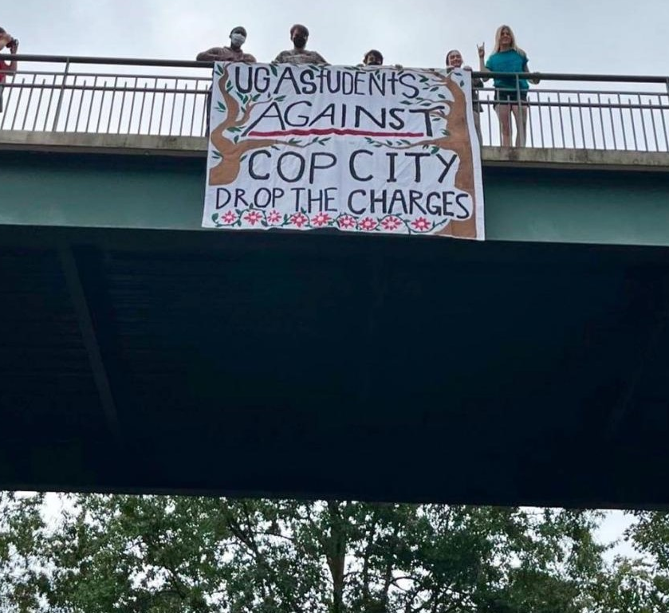
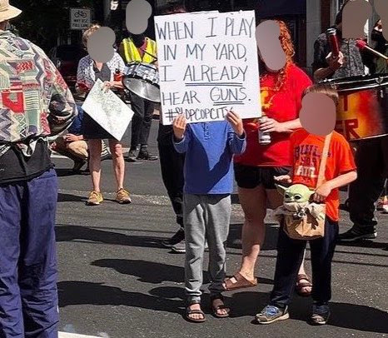
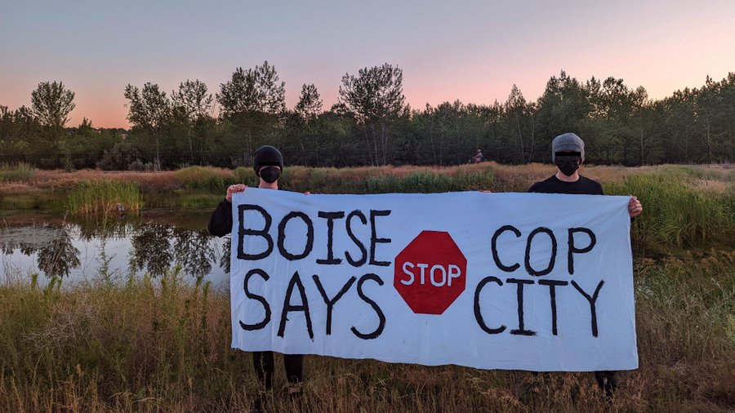
Planejando uma Campanha
REFERÊNCIAS: COMO sabemos se estamos chegando lá.
Isso é mensurável? Como podemos medir isso? (Não apenas números!)
Como podemos nos certificar de que o atingimos? E se não conseguirmos?
O que isso pode revelar sobre nossos pontos fortes/limites?
I
Notes:
(SLIDE 20) Benchmarks
Definition: How we know if we’re on our way.
Example:
Quantitative: In the rezoning fight, we wanted to steadily increase attendance at our protests and decrease attendance at city-sponsored listening sessions.
Qualitative: In the rezoning fight, we wanted people to connect gentrification with developers and the Democratic political machine in the Bronx.
Guiding Questions
Is this measurable? / How do we measure it?
What steps are needed to make sure we hit our benchmark?
What will we do if we don’t hit our benchmark?
Can be used to test our power.
Reminder: Goals, strategy and tactics are fluid, shifting and overlapping. Not linear. You almost never set a goal in a vacuum and then plan out fixed strategy and tactics. Instead, you're constantly experimenting with new tactics and redefining your goal and how to get there, and they're all influencing each other.
Segway into example and table: now we're going to break down how these elements came together in the rezoning campaign I mentioned

Slide 17
OBJETIVOS | ESTRATÉGIA | TÁTICAS
Conseguir a readmissão de motoristas demitidos | Convencer os patrões a fazer a coisa certa | Solicitar reuniões fechadas com chefes e apoiadores externos

Slide 18
OBJETIVOS | ESTRATÉGIA | TÁTICAS
Conseguir a readmissão de motoristas demitidos | Convencer o patrão a fazer a coisa certa. -Isso constrói poder / autonomia / agência para nós? | Solicitar reuniões fechadas com chefes e apoiadores externos -Confronto? -Pessoas comuns? -Estimula ou afasta a participação?

Slide 19
OBJETIVOS | ESTRATÉGIA | TÁTICAS
Conseguir a readmissão de motoristas demitidos | Convencer o patrão a fazer a coisa certa. -Isso constrói poder / autonomia / agência para nós? | Solicitar reuniões fechadas com chefes e apoiadores externos -Confronto? -Pessoas comuns? -Estimula ou afasta a participação?
Criar uma organização independente e autossustentável de motoristas de ônibus capazes de lutar e vencer. | Aumentar a participação e a liderança dos motoristas para enfrentar o município. Criar infraestrutura que possa se estender além da greve.
Desenvolver a militância nos locais de trabalho da região X. | Conectar a luta dos motoristas a outras lutas no país. Obter apoio externo.

Slide 20
OBJETIVOS | ESTRATÉGIA | TÁTICAS
Conseguir a readmissão de motoristas demitidos | Denunciar publicamente as demissões. Continue a aumentar o poder dos trabalhadores para forçar a recontratação dos motoristas. | Motoristas demitidos organizam uma coletiva de imprensa. Reuniões de motoristas. Motoristas participam juntos de reuniões do conselho escolar vestindo vermelho.
Criar uma organização independente e autossustentável de motoristas de ônibus capazes de lutar e vencer. | Aumentar a participação e a liderança dos motoristas para enfrentar o município. Criar infraestrutura que possa se estender além da greve.
Desenvolver a militância nos locais de trabalho da região X. | Conectar a luta dos motoristas a outras lutas no país. Obter apoio externo.

Slide 21
OBJETIVO | ESTRATÉGIA | TÁTICAS

Slide 22
Pausa
Notes:
(SLIDE 26) Breakout activity
Now let’s do a breakout where you build a table of goals, strategy, and tactics for a campaign that you know
We will breakout into groups based on shared campaigns we’ve participated in together
Pick someone to share back from the group. We will reconvene in 15 minutes

Slide 23
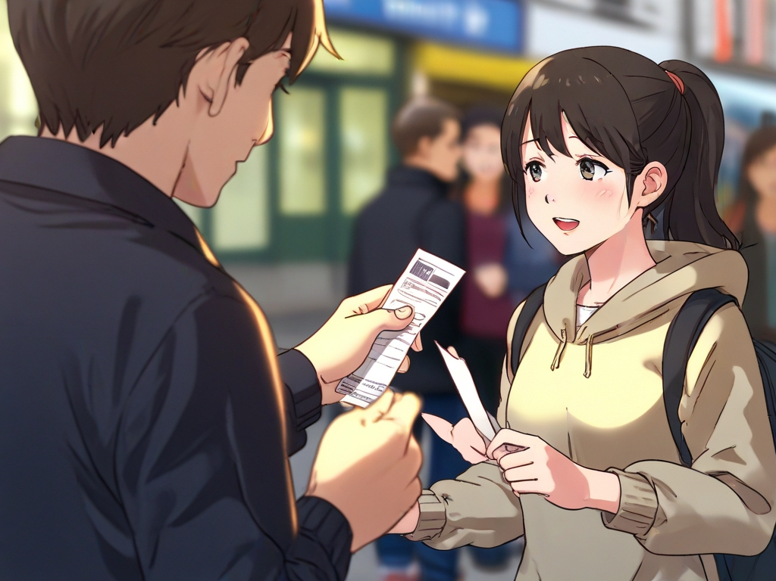
Conversando sobre Política
Militonto
Joana

Slide 24
Conversando Sobre Política
Exemplo:
O que deu errado?
O que você teria feito?

Slide 25
Conversando Sobre Política
"A política é uma atividade social. Ao ouvir as experiências, os sentimentos e as ideias das pessoas e dialogar com elas, não apenas divulgamos ideias. Também aprendemos sobre a sociedade, ajudamos as pessoas a resolver seus próprios conflitos internos e a agir para mudar o mundo. É para isso que serve a política revolucionária."

Slide 26
Conversando Sobre Política
Apatia, medo, divisão ➜ unidade e determinação
Não acontece em uma única conversa
Nem sempre verbal
20% fala, 80% escuta
Notes:
If we agree that ppl’s minds change primarily through action, then...

Slide 27
A-E-I-O-U
Agitar
Educar
Imunizar
Organizar
Unir

Slide 28
AGITAR
Aborde um problema.
Entenda a questão.
Traga o ódio a tona.
Valide este ódio.
FAÇA PERGUNTAS

Slide 29
AGITAR
NÃO DÊ AULAS
Faça perguntas abertas.
Compartilhe do ódio.
Ligue o problema à situação geral

Slide 30
EDUCAR
Proponha a solução: Ação Coletiva
Educar sempre depois de agitar.
AGITAR-EDUCAR-AGITAR-EDUCAR-AGITAR-EDUCAR-AGIDUCAR

Slide 31
EDUCAR
Tenha exemplos à mão... e ouça as ideias deles.
Faça perguntas abertas
Dê esperança
Transmita um senso de urgência

Slide 32
IMUNIZAR
Prepara para as possíveis consequências
“O que pode acontecer sairmos juntos antes do patrão pedir as comissões?”
ISSO É NECESSÁRIO
NÃO PULE

Slide 33
IMUNIZAR
“Quais táticas eles podem usar para nos parar?”
O que eles estão esperando?
O que eles não estão esperando?

Slide 34
IMUNIZAR
Não pare por aí, volte a AGITAR E EDUCAR.
A IMUNIZAÇÃO gera confiança.

Slide 35
ORGANIZAR
Consiga um compromisso
Tarefas claras e específicas
Pequeno alcance, mas realizável
Adaptar-se a essa pessoa

Slide 36
ORGANIZAR
"Você falará sobre sua história na reunião?"
"Você se comprometerá a estar presente no dia em que fizermos a entrega?"
"Você pedirá a dois colegas de trabalho que tenham uma dessas conversas com você e comigo?"
"Você pode conseguir assinaturas de 5 vizinhos?

Slide 37
ORGANIZAR
Acompanhamento
"Ótimo, você conversará com fulano na terça-feira à noite. Entrarei em contato com você na quarta-feira de manhã para saber como foi."
Suporte
"Você já panfletou antes? Vamos colocá-lo em contato com alguém que já tenha feito isso para que ele possa dar dicas de como fazer."

Slide 38
UNIR
Retornar às etapas para aprofundar nossa determinação coletiva.
Ações Mais Fortes

Slide 39
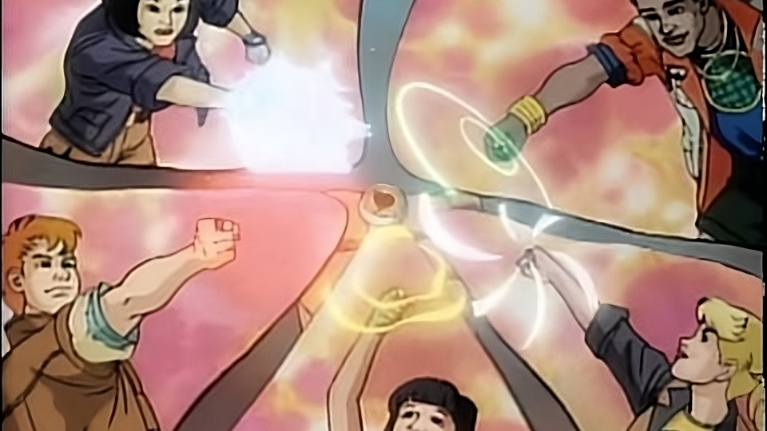
UM GRANDE ORGANIZADOR
Notes:
(SLIDE 26) Breakout activity
Now let’s do a breakout where you build a table of goals, strategy, and tactics for a campaign that you know
We will breakout into groups based on shared campaigns we’ve participated in together
Pick someone to share back from the group. We will reconvene in 15 minutes

Slide 40
A-E-I-O-U
Agitar: Abordar um problema
Educar: Propor uma solução
Imunizar: Antecipar dificuldades
Organizar: Conseguir compromisso
Unir: Aprofundar a determinação coletiva.

Slide 41
Pausa

Slide 42
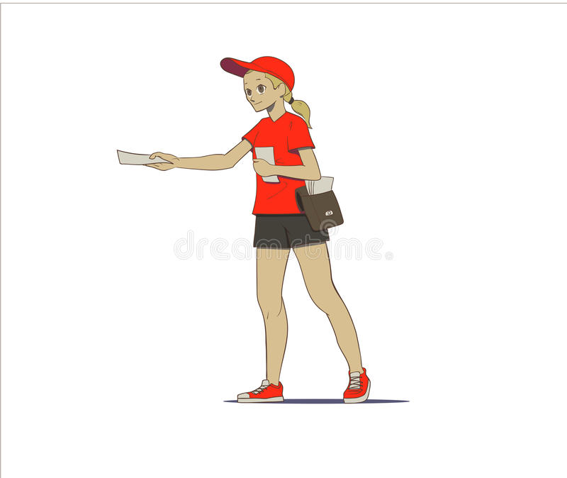
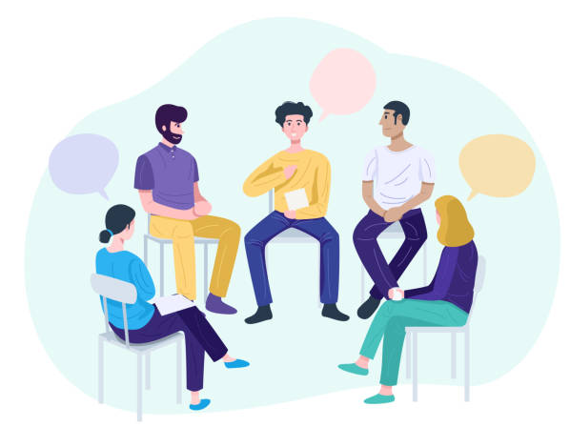
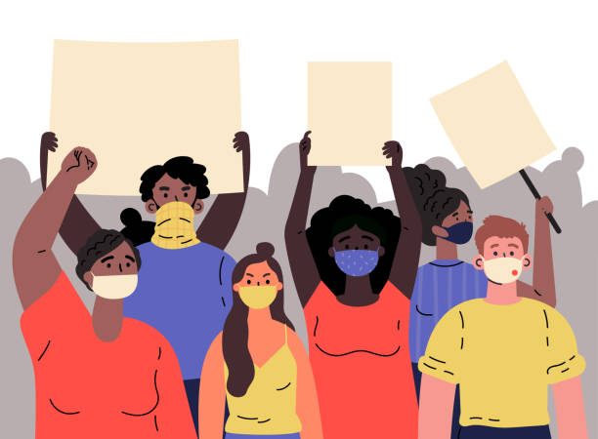
Prática do Dia a Dia
Promover Relacionamentos
Integrar novos membros
Refletir
Fazer sentido
Notes:
(SLIDE 28) The day-to-day
We’ve defined autonomous organizing and outlined how to wage campaigns. In this final section, let’s explore day-to-day practices that help build autonomous organizations.
As we organize and develop campaigns day-to-day, we work to
Foster relationships
Integrate and develop members in our autonomous organizations
Reflect on and improve our activities
Make meaning out of our milestones, setbacks and victories

Slide 43
1. Promover Relacionamentos
Como podemos construir relacionamentos com respeito mútuo, confiança e cuidado?
Aproveite todas as oportunidades
Seja intencional
Dê continuidade
Notes:
(SLIDE 29) How do we build relationships with people?
Intro
It matters how many people your organization knows and integrates.
But anyone can make a listserv or gather 100 contacts on a signup sheet. We don’t just want to “turn people out” like numbers.
What’s more important is the quality of relationships you build with people.
How do we build real relationships that entail mutual respect, trust, and care?
Take every opportunity
Every meeting, action, flyering (etc) is an opportunity to meet someone you could collaborate with
Some leftist events can be cliquey. But the point is to be outgoing and connect.
This can be challenging if you’re an introvert like me. Challenge yourself! In changing the world we change ourselves!
Be intentional
Set goals: for this event, what types of people, how many, do you want to meet?
Example: at an open meeting, we prioritize meeting first-time attendees and aim to get their contact info
Write down memories of the people you meet. Otherwise you will forget!
Follow up
Check in about follow-ups at meetings: who is following up with who?
Invite the person to coffee, meet at an event or action, etc. In-person is best. Work around their availability.
Be direct about what you want to discuss: hear what they thought, to see if you can collaborate, to invite them into the organizing (because you think they’d care about the issue, they have unique perspective and skills, etc)

Slide 44
1. Promover Relacionamentos
Lembre-se
A construção de relacionamentos é responsabilidade de todos
Considere as posições sociais
Seja honesto
Tudo acaba. E depois?
Notes:
(SLIDE 33) Remember
Relationship-building is everyone’s responsibility
One person can’t hold all the contacts
The more your organization is a web, where each person knows several others, the stronger it is
Consider your social positions
You don’t want anyone to think you’re asking them on a date
Each person brings a unique perspective, skills, knowledge
Be honest when you build with people
Establish trust and forthrightness from jump
Don’t promise what you can’t deliver
We don’t save people. We offer what we can to struggle together.
Every campaign or organization ends
When this happens, what will we have to show for it?
If we’re successful, we will have waged campaigns, raised political consciousness, weakened the ruling class etc
Most important: we’ll have built up networks of people with experiences of struggle

Slide 45
2. Integrar Novos Membros
Como podemos integrar novos membros ou participantes das nossas ações?
Planeje com antecedência
Tarefas discretas e significativas
Suporte
Treine como você luta
Considere cada membro
Notes:
(SLIDE 34-35) Integrate new members
POSE QUESTION: After any event or activity, you may have new people trying to join your project. How will you integrate them into the work?
It helps to plan ahead
As you plan one event/action, what will be the next activity you invite new people you meet to?
Invite new members to do discrete, meaningful tasks
Research shows people get involved with new groups when they can start with tasks that are limited in scope, just challenging enough, and whose contribution to the larger goal is clear
Scaffolding
Think of your organization as a collection of activities, each one preparing members to take on the next-most-complex one. Aka “scaffolding”
You can also “scaffold” activities by making them easier the first time around. For example, by pairing a new member with an experienced member
Train for how you fight
Think about what tactics your group will have to carry out to pursue your strategy. Then, build scaffolding and trainings for these activities.
Example: If door-knocking or tabling is one tactic you use, then your group will need to get good at talking to people. Spend meeting time practicing conversations and reflecting after door-knocking.
Example: If you host large public events, you’ll need strong facilitators. Spend meeting time discussing ideal facilitation styles, rotating facilitation in your own meetings, etc.
Consider each member
Sometimes it helps to take stock of each member individually, and how they are growing. You can do this collectively too.
What are members skilled at already? Where do they know they need to grow? How do they want to challenge themselves?
What skills do they improve at quickly? What skills could they develop that the group needs?

Slide 46
3. Refletir
Não perca a direção.
Revisite as metas, a estratégia e as táticas.
Inclua a reflexão nas reuniões.
Notes:
(SLIDE 38) Reflection
Without it, you can lose direction and become reactive, or gloss over problems that could lead to defeat
Revisit your goals, strategy and tactics at turning points in your organizing
How do your current activities fit into the overall strategy?
How do your results compare with your benchmarks? What do you make of this?
Has anything changed that might cause you to try new tactics, adjust your strategy, or redefine your goals?
Build reflection into your meetings, or schedule reflection meetings specifically for it

Slide 47
4. Criar Significado
Desenvolver um entendimento compartilhado do significado mais amplo de nossos esforços, contratempos e vitórias
Responde à pergunta "qual é o sentido?"
Reafirma o propósito, a comunidade e a esperança.
Dá força emocional e convicção.
Exemplos?
Notes:
(SLIDE 39) Make Meaning
Define
By “make meaning” we mean developing a shared understanding of the broader significance of our efforts, setbacks and victories, beyond their immediate contribution to a given campaign
This aspect of organizing is often forgotten, but it is very important
Helps us answer existential “what’s the point” questions
Reaffirms purpose, community, and hope in the face of cynicism, smallness and hopelessness
Gives us emotional strength and conviction to continue in the struggle
Can you think of any examples of how organizations make meaning?
Throwing a party to celebrate achieving a benchmark or winning a small victory
Hosting a welcome event for new members
Holding a memorial for a member who has passed away
Opening or closing public meetings with a song
Dedications in group writings
Naming buildings after significant dates or people

Slide 48
Revisão
Definindo “organização”
cócoras
Planejando uma Campanha
Terreno, Objetivos, Estratégia, Táticas e Referências
Conversando sobre Política
AEIOU
Práticas do dia a dia
Promover Relacionamentos, Integrar Novos Mebros, Desenvolver Habilidades, Refletir, Criar Significado.
Notes:
box

Slide 49
Obrigado por participar!
Referências
A tradição radical negra
"Talking Politics" de Stan Weir
LaborNotes "Secrets of a Successful Organizer" (Segredos de um organizador bem-sucedido)
Powerpoint "How to have a good organizing conversation" (Como ter uma boa conversa sobre organização)
Treinamento de Organizadores 101 da IWW
Todos os nossos erros, que são oportunidades de aprendizado.
Notes:
Box

